Slide 1

IT5002
Computer Systems and Applications
MIPS Assembly II
colintan@nus.edu.sg

Slide 2
Q & A
DO NOT use the Zoom chat for questions. It doesn’t appear in the video recordings.
Please ask questions at https://sets.netlify.app/module/6783ad89fc362746fec52180
OR scan this QR code (may be obscured on some slides)

Slide 3
Lecture #8: MIPS Part 2: More Instructions
Memory Organisation (General)
  1.1 Memory: Transfer Unit
  1.2 Memory: Word Alignment
MIPS Memory Instructions
  2.1 Memory Instruction: Load Word
  2.2 Memory Instruction: Store Word
  2.3 Load and Store Instructions
  2.4 Memory Instruction: Others
  2.5 Example: Array
  2.6 Common Questions
  2.7 Example: Swapping Elements

Slide 4
Lecture #8: MIPS Part 2: More Instructions
Making Decisions
  3.1 Conditional Branch: beq and bne
  3.2 Unconditional Jump: j
  3.3 IF statement
  3.4 Exercise #1: IF statement
Loops
  4.1 Exercise #2: FOR loop
  4.2 Inequalities
Array and Loop
Exercises

Slide 5
1. Memory Organisation (General)
The main memory can be viewed as a large, single-dimension array of memory locations.
Each location of the memory has an address, which is an index into the array.
  Given a k-bit address, the address space is of size 2^{k}.
The memory map on the right contains one byte (8 bits) in every location/address.
  This is called byte addressing
Address
Content
0
8 bits
1
8 bits
2
8 bits
3
8 bits
4
8 bits
5
8 bits
6
8 bits
7
8 bits
8
8 bits
9
8 bits
10
8 bits
11
8 bits
:

Slide 6
1.1 Memory: Transfer Unit
Using distinct memory address, we can access:
  a single byte (byte addressable) or
  a single word (word addressable)
Word is:
  Usually 2^{n} bytes
  The common unit of transfer between processor and memory
  Also commonly coincide with the register size, the integer size and instruction size in most architectures

Slide 7
1.2 Memory: Word Alignment
Word alignment:
  Words are aligned in memory if they begin at a byte address that is a multiple of the number of bytes in a word.
Example: If a word consists of 4 bytes, then:
Address
Aligned word
0
Byte 0
1
Byte 1
Mis-aligned word
2
Byte 2
3
Byte 3
Question:
How do we quickly check whether a given memory address is word-aligned or not?
4
Byte 4
5
Byte 5
6
Byte 6
7
Byte 7
Notes:
Address % 4 == 0
Last 2-bits == 0

Slide 8
2. MIPS Memory Instructions
MIPS is a load-store register architecture
  32 registers, each 32-bit (4 bytes) long
  Each word contains 32 bits (4 bytes)
  Memory addresses are 32-bit long
Answer: So that they fit into registers
Why?
Name | Examples | Comments
32 registers | $s0-$s7, $t0-$t9, $zero, $a0-$a3, $v0-$v1, $gp, $fp, $sp, $ra, $at | Fast processor storage for data. In MIPS, data must be in registers to perform arithmetic.
2³⁰ memory words | Mem[0], Mem[4], …, Mem[4294967292] | Accessed only by data transfer instructions. MIPS uses byte addresses, so consecutive words differ by 4. Memory holds data structures, such as arrays, and spilled registers, such as those saved on procedure calls.


Slide 9
2.1 Memory Instruction: Load Word
Example: lw $t0, 4($s0)
Processor
Memory
………..
$s0
8000
8000
8001
$t0
1
8002
8003
Offset = +4
8004
8005
2
8006
8007
………..
Steps:
  Memory Address = $s0 + 4 = 8000 + 4 = 8004
  Memory word at Mem[8004] is loaded into $t0

Slide 10
2.2 Memory Instruction: Store Word
Example: sw $t0, 12($s0)
Processor
Memory
………..
$s0
8000
8000
8001
$t0
1
8002
……
………
Offset = +12
8012
8013
2
8014
8015
………..
Steps:
  Memory Address = $s0 + 12 = 8000 + 12 = 8012
  Content of $t0 is stored into word at Mem[8012]

Slide 11
2.3 Load and Store Instructions
Only load and store instructions can access data in memory.
Example: Each array element occupies a word.
  Each array element occupies a word (4 bytes).
  $s3 contains the base address (address of first element, A[0]) of array A. Variable h is mapped to $s2 .
Remember arithmetic operands (for add) are registers, not memory!
C Code | MIPS Code
A[7] = h + A[10]; | lw $t0, 40($s3) add $t0, $s2, $t0 sw $t0, 28($s3)

Slide 12
2.4 Memory Instructions: Others (1/2)
Other than load word (lw) and store word (sw), there are other variants, example:
  load byte (lb)
  store byte (sb)
Similar in format:
  lb $t1, 12($s3)
  sb $t2, 13($s3)
Similar in working except that one byte, instead of one word, is loaded or stored
  Note that the offset no longer needs to be a multiple of 4

Slide 13
2.4 Memory Instructions: Others (2/2)
MIPS disallows loading/storing unaligned word using lw/sw:
  Pseudo-Instructions unaligned load word (ulw) and unaligned store word (usw) are provided for this purpose
Other memory instructions:
  lh and sh: load halfword and store halfword
  lwl, lwr, swl, swr: load word left / right, store word left / right.
  etc…

Slide 14
2.5 Example: Array (assume 4 bytes per element)
C Statement to translate | Variables Mapping
A[3] = h + A[1]; | h ➔ $s2 base of A[] ➔ $s3
$s3
A[0]
lw $t0, 4($s3)
add $t0, $s2, $t0
sw $t0, 12($s3)
4($s3)
A[1]
A[2]
12($s3)
A[3]

Slide 15
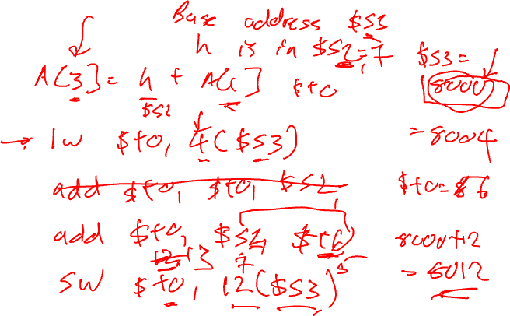

Slide 16
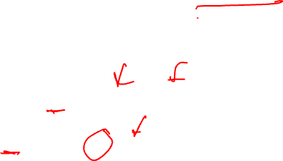
2.6 Common Questions: Address vs Value
Key concept:
Registers do NOT have types
A register can hold any 32-bit number:
  The number has no implicit data type and is interpreted according to the instruction that uses it
Examples:
  add $t2, $t1, $t0
  ➔ $t0 and $t1 should contain data values
  lw $t2, 0($t0)
  ➔ $t0 should contain a memory address

Slide 17
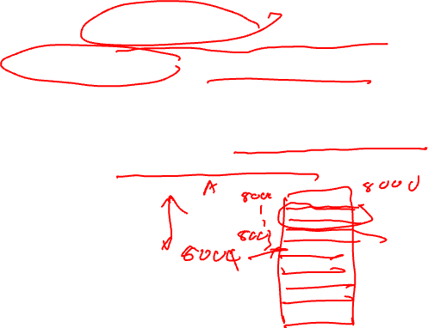
2.6 Common Questions: Byte vs Word
Important:
Consecutive word addresses in machines with byte-addressing do not differ by 1
Common error:
  Assume that the address of the next word can be found by incrementing the address in a register by 1 instead of by the word size in bytes
For both lw and sw:
  The sum of base address and offset must be a multiple of 4 (i.e. to adhere to word boundary)

Slide 18
2.7 Example: Swapping Elements
C Statement to translate | Variables Mapping
swap( int v[], int k ) { int temp; temp = v[k] v[k] = v[k+1]; v[k+1] = temp; } | k ➔ $5 Base address of v[] ➔ $4 temp ➔ $15
Example: k = 3; to swap v[3] with v[4].
Assume base address of v is 2000.
$5 (k) ← 3
$4 (base addr. of v) ← 2000
swap:
sll $2, $5, 2
add $2, $4, $2
lw $15, 0($2)
lw $16, 4($2)
sw $16, 0($2)
sw $15, 4($2)
$2 ← 12
$2 ← 2012
$15 ← content of mem. addr. 2012 (v[3])
$16 ← content of mem. addr. 2016 (v[4])
content of mem. addr. 2012 (v[3]) ← $16
content of mem. addr. 2016 (v[4]) ← $15

Note: This is simplified and may not be a direct translation of the C code.

Slide 19
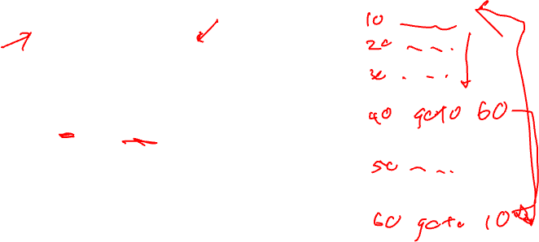
3. Making Decisions (1/2)
We cover only sequential execution so far:
  Instruction is executed in program order
To perform general computing tasks, we need to:
  Make decisions
  Perform iterations (in later section)
Decisions making in high-level language:
  if and goto statements
  MIPS decision making instructions are similar to if statement with a goto
    goto is discouraged in high-level languages but necessary in assembly ☺

Slide 20

3. Making Decisions (2/2)
Decision-making instructions
  Alter the control flow of the program
  Change the next instruction to be executed
Two types of decision-making statements in MIPS
  Conditional (branch)
  bne $t0, $t1, label
  beq $t0, $t1, label
  Unconditional (jump)
  j label
A label is an “anchor” in the assembly code to indicate point of interest, usually as branch target
  Labels are NOT instructions!

Slide 21

3.1 Conditional Branch: beq and bne
Processor follows the branch only when the condition is satisfied (true)
beq $r1, $r2, L1
  Go to statement labeled L1 if the value in register $r1 equals the value in register $r2
  beq is “branch if equal”
  C code: if (a == b) goto L1
bne $r1, $r2, L1
  Go to statement labeled L1 if the value in register $r1 does not equal the value in register $r2
  bne is “branch if not equal”
  C code: if (a != b) goto L1

Slide 22
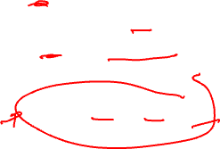
3.2 Unconditional Jump: j
Processor always follows the branch
j L1
  Jump to label L1 unconditionally
  C code: goto L1
Technically equivalent to such statement
  beq $s0, $s0, L1

Slide 23

3.3 IF statement (1/2)
C Statement to translate | Variables Mapping
if (i == j) f = g + h; | f ➔ $s0 g ➔ $s1 h ➔ $s2 i ➔ $s3 j ➔ $s4
beq $s3, $s4, L1
j Exit
L1: add $s0, $s1, $s2
Exit:
bne $s3, $s4, Exit
add $s0, $s1, $s2
Exit:
Two equivalent translations:
  The one on the right is more efficient
Common technique: Invert the condition for shorter code

Slide 24

3.3 IF statement (2/2)
C Statement to translate | Variables Mapping
if (i == j) f = g + h; else f = g - h; | f ➔ $s0 g ➔ $s1 h ➔ $s2 i ➔ $s3 j ➔ $s4
bne $s3, $s4, Else
add $s0, $s1, $s2
j Exit
Else: sub $s0, $s1, $s2
Exit:
true
false
i==j?
Else:
f = g+h
f = g-h
Question: Rewrite with beq?
Exit:

Slide 25
3.4 Exercise #1: IF statement
MIPS code to translate into C | Variables Mapping
beq $s1, $s2, Exit add $s0, $zero, $zero Exit: | f ➔ $s0 i ➔ $s1 j ➔ $s2
What is the corresponding high-level statement?
if (i != j) {
f = 0;
}


Slide 26
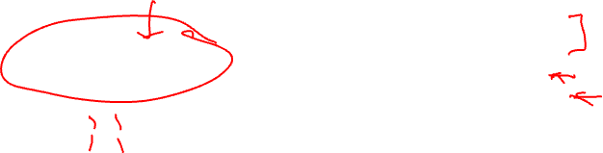
4. Loops (1/2)
C while-loop:
Rewritten with goto
while (j == k)
i = i + 1;
Loop: if (j != k)
goto Exit;
i = i+1;
goto Loop;
Exit:
Key concept:
Any form of loop can be written in assembly with the help of conditional branches and jumps.

Slide 27
4. Loops (2/2)
C Statement to translate | Variables Mapping
Loop: if (j != k) goto Exit; i = i+1; goto Loop; Exit: | i ➔ $s3 j ➔ $s4 k ➔ $s5
What is the corresponding MIPS code?
Loop: bne $s4, $s5, Exit # if (j!= k) Exit
addi $s3, $s3, 1
j Loop # repeat loop
Exit:


Slide 28

4.1 Exercise #2: FOR loop
Write the following loop statement in MIPS
C Statement to translate | Variables Mapping
for ( i=0; i<10; i++) a = a + 5; | i ➔ $s0 a ➔ $s2
add $s0, $zero, $zero
addi $s1, $zero, 10
Loop: beq $s0, $s1, Exit
addi $s2, $s2, 5
addi $s0, $s0, 1
j Loop
Exit:


Slide 29
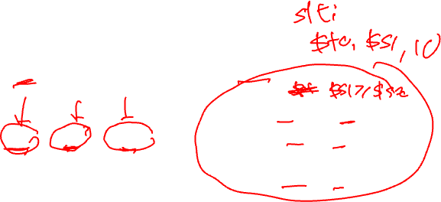
4.2 Inequalities (1/2)
We have beq and bne, what about branch-if-less-than?
  There is no real blt instruction in MIPS
Use slt (set on less than) or slti.
if ($s1 < $s2)
$t0 = 1;
else
$t0 = 0;
slt $t0, $s1, $s2
=

Slide 30
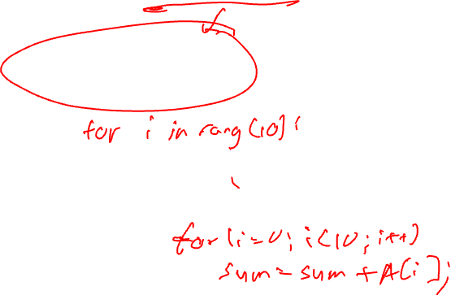
4.2 Inequalities (2/2)
To build a “blt $s1, $s2, L” instruction:
This is another example of pseudo-instruction:
  Assembler translates (blt) instruction in an assembly program into the equivalent MIPS (two) instructions
slt $t0, $s1, $s2
bne $t0, $zero, L
if ($s1 < $s2)
goto L;
==

Slide 31
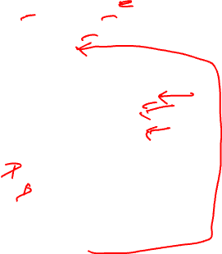
5. Array and Loop
Typical example of accessing array elements in a loop:
Initialization for result variables, loop counter, and array pointers.
Label:
Work by:
Calculating address
Load data
Perform task
Update loop counter and array pointers.
Compare and branch.

Slide 32
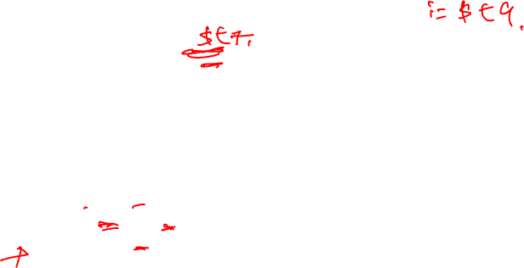
5. Array and Loop: Question
Count the number of zeros in an Array A
A is word array with 40 elements
Address of A[] ➔ $t0, Result ➔ $t8
Simple C Code
result = 0; i = 0; while ( i < 40 ) { if ( A[i] == 0 ) result++; i++; }
Think about:
  How to perform the right comparison
  How to translate A[i] correctly

Slide 33
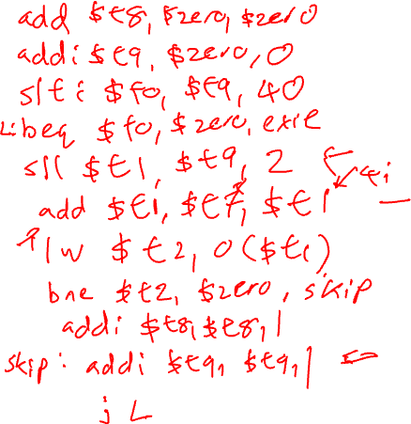

Slide 35
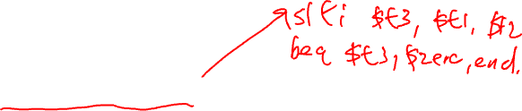
5. Array and Loop: Version 1.0
Address of A[] ➔ $t0 Result ➔ $t8 i ➔ $t1 | Comments
addi $t8, $zero, 0 addi $t1, $zero, 0 addi $t2, $zero, 40 loop: bge $t1, $t2, end sll $t3, $t1, 2 add $t4, $t0, $t3 lw $t5, 0($t4) bne $t5, $zero, skip addi $t8, $t8, 1 skip: addi $t1, $t1, 1 j loop end: | # end point # i * 4 # &A[i] # $t3 ⬅ A[i] # result++ # i++

Slide 36
5. Array and Loop: Version 2.0
Address of A[] ➔ $t0 Result ➔ $t8 &A[i] ➔ $t1 | Comments
addi $t8, $zero, 0 addi $t1, $t0, 0 addi $t2, $t0, 160 loop: bge $t1, $t2, end lw $t3, 0($t1) bne $t3, $zero, skip addi $t8, $t8, 1 skip: addi $t1, $t1, 4 j loop end: | # addr of current item # &A[40] # comparing address! # $t3 ⬅ A[i] # result++ # move to next item
Use of “pointers” can produce more efficient code!

Slide 37
6.1 Exercise #3: Simple Loop
Given the following MIPS code:
  addi $t1, $zero, 10
  add $t1, $t1, $t1
  addi $t2, $zero, 10
  Loop: addi $t2, $t2, 10
  addi $t1, $t1, -1
  beq $t1, $zero, Loop
Answer: (a)
How many instructions are executed?
  (a) 6 (b) 30 (c) 33 (d) 36 (e) None of the above
What is the final value in $t2?
  (a) 10 (b) 20 (c) 300 (d) 310 (e) None of the above
Answer: (b)


Slide 38
6.2 Exercise #4: Simple Loop II
Given the following MIPS code:
  add $t0, $zero, $zero
  add $t1, $t0, $t0
  addi $t2, $t1, 4
  Again: add $t1, $t1, $t0
  addi $t0, $t0, 1
  bne $t2, $t0, Again
How many instructions are executed?
  (a) 6 (b) 12 (c) 15 (d) 18 (e) None of the above
What is the final value in $t1?
  (a) 0 (b) 4 (c) 6 (d) 10 (e) None of the above
Answer: (c)
Answer: (c)


Slide 39
6.3 Exercise #5: Simple Loop III (1/2)
Given the following MIPS code accessing a word array of elements in memory with the starting address in $t0.
addi $t1, $t0, 10
  add $t2, $zero, $zero
  Loop: ulw $t3, 0($t1) # ulw: unaligned lw
  add $t2, $t2, $t3
  addi $t1, $t1, -1
  bne $t1, $t0, Loop
How many times is the bne instruction executed?
  (a) 1 (b) 3 (c) 9 (d) 10 (e) 11
How many times does the bne instruction actually branch to the label Loop?
  (a) 1 (b) 8 (c) 9 (d) 10 (e) 11
Answer: (d)
Answer: (c)


Slide 40
6.3 Exercise #5: Simple Loop III (2/2)
Given the following MIPS code accessing a word array of elements in memory with the starting address in $t0.
addi $t1, $t0, 10
  add $t2, $zero, $zero
  Loop: ulw $t3, 0($t1) # ulw: unaligned lw
  add $t2, $t2, $t3
  addi $t1, $t1, -1
  bne $t1, $t0, Loop
How many instructions are executed?
  (a) 6 (b) 12 (c) 41 (d) 42 (e) 46
How many unique bytes of data are read from the memory?
  (a) 4 (b) 10 (c) 11 (d) 13 (e) 40
Answer: (d)
Answer: (d)


Slide 42
Summary: Focus of IT5002
Basic MIPS programming
  Arithmetic: among registers only
  Handling of large constants
  Memory accesses: load/store
  Control flow: branch and jump
  Accessing array elements
  System calls (covered in labs)
Things we are not going to cover
  Support for procedures
  Linkers, loaders, memory layout
  Stacks, frames, recursion
  Interrupts and exceptions

